Slide 1
Tracking fatigue after brain injury using a smart-phone app and sensors/wearables
Lewis, Max, Michelle, Peik Xin, Thomas

Slide 2

Introduction
Problem: A majority of patients admitted to the hospital have acquired brain injury and this massively affects their cognitive abilities hindering their daily lives. The main effect brain injury has on patients is fatigue. Managing fatigue and improving the impact it has on daily life is difficult due to the unpredictable nature of it.
Solution: Develop a smart-phone app to aid patients the ability to gain a greater understanding of their fatigue levels and learn how to manage them. As a result this could improve the impact that fatigue has on their daily lives.
Previously…
Implemented the design from Figma
Environment for app development; android studio, Git repo
Results weren’t collected yet
Login page; integration with google and facebook
Dashboard
Testing Ethics
Accomplishments
Implementation of notification system
Reaction time tests
Integration with FitBit
Dashboard, daily summary
Testing the app.

Slide 3
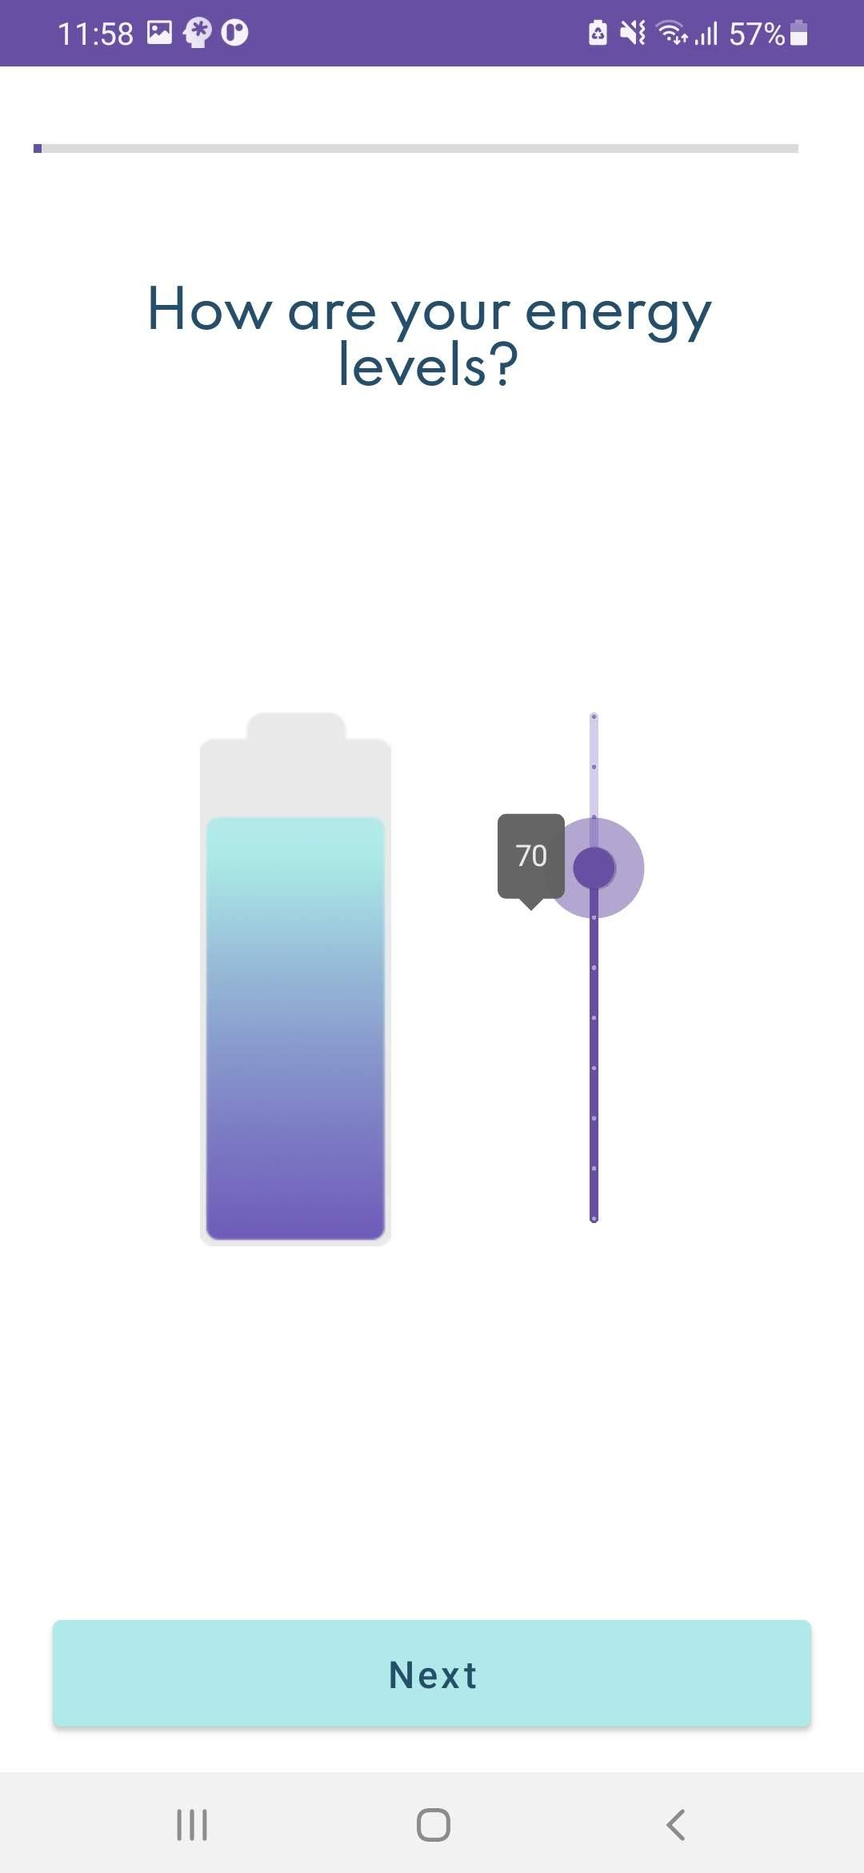

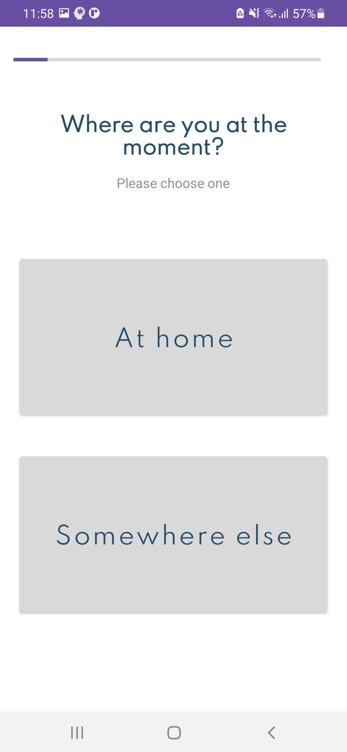
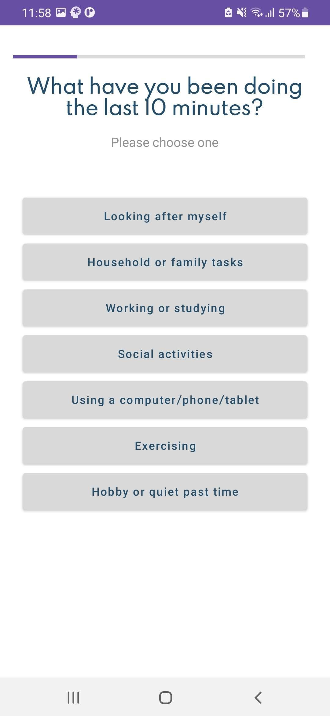
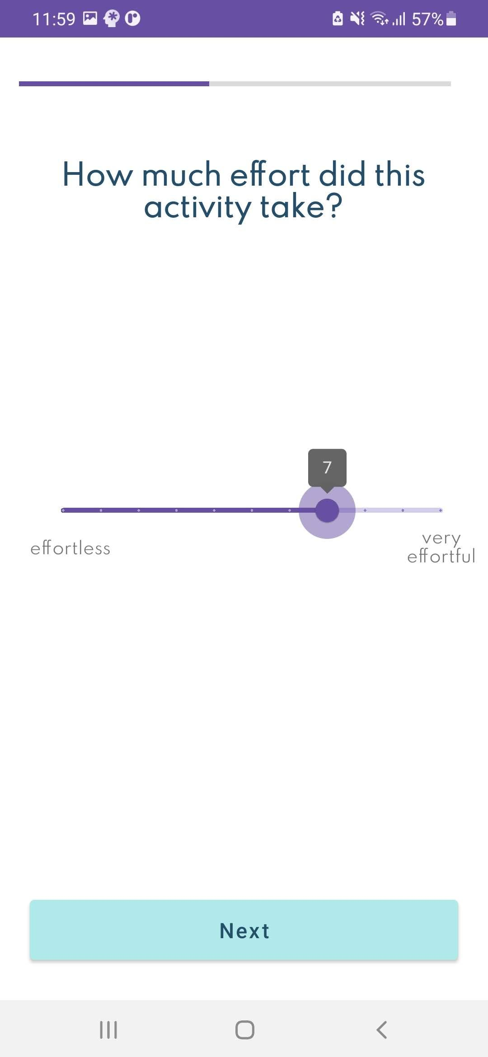
User Surveys
The user surveys are the backbone of our app's data collection. We designed them based on the structure given by our customer and aimed to implement a clean user interface/experience.
This was achieved by providing a dynamic system that wasn’t just a series of buttons but provided sliders, a progress bar and a battery visualisation.
The survey results are collected by the app and stored within the app itself. This data is then passed over to the dashboard. Finishing the survey also sets up the next survey notification.

Slide 4
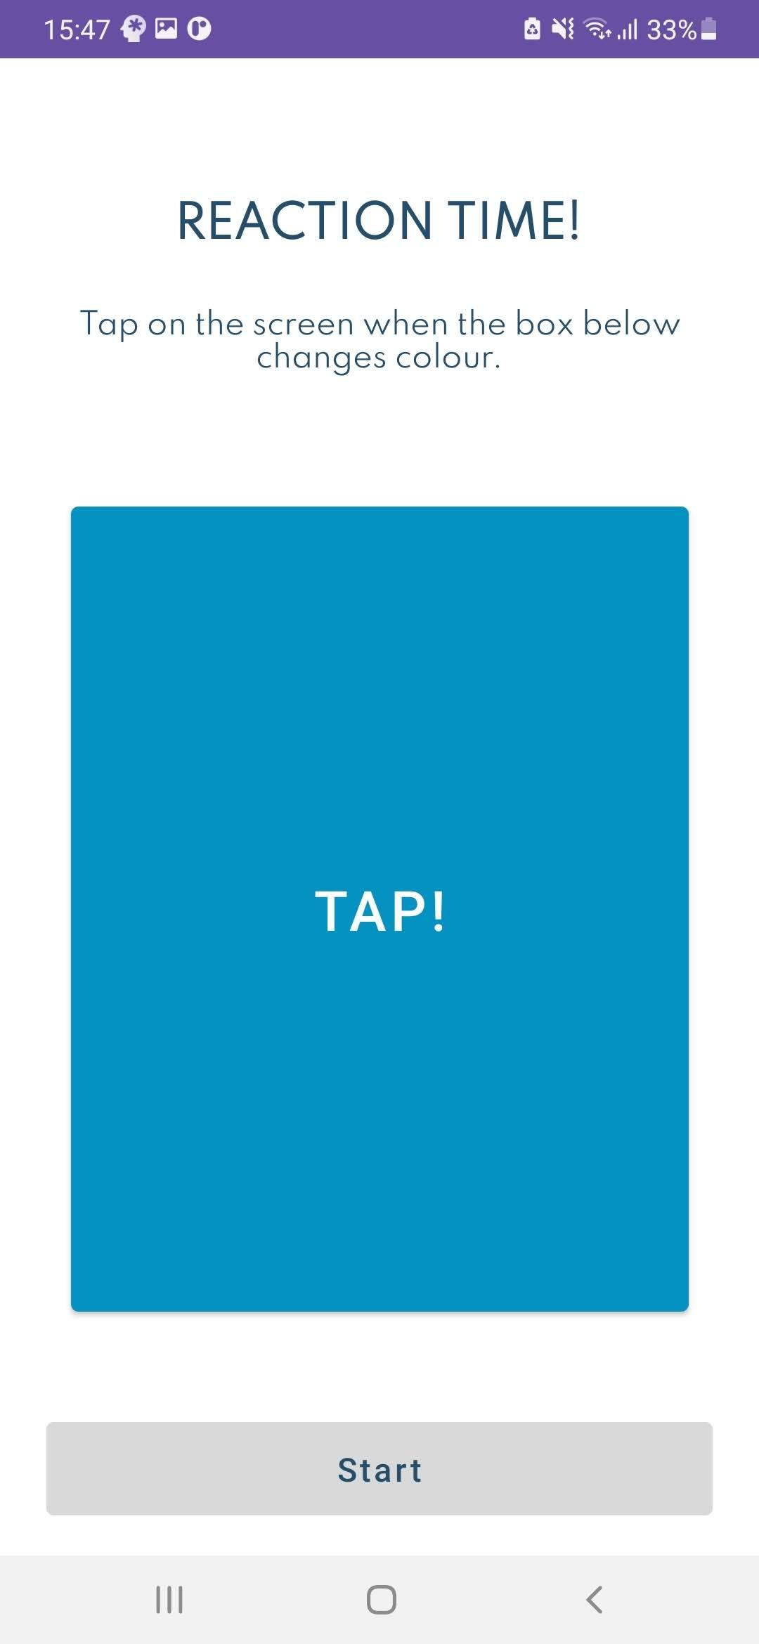
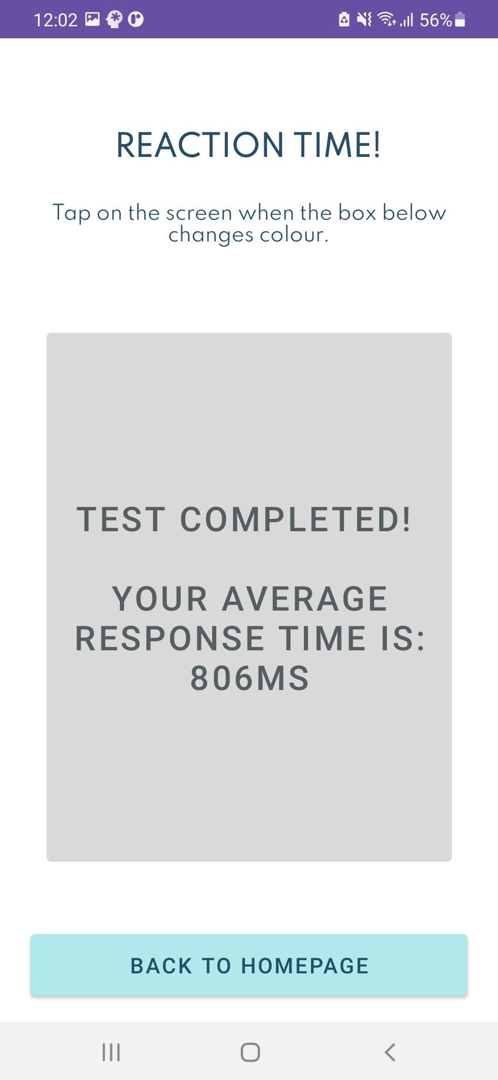
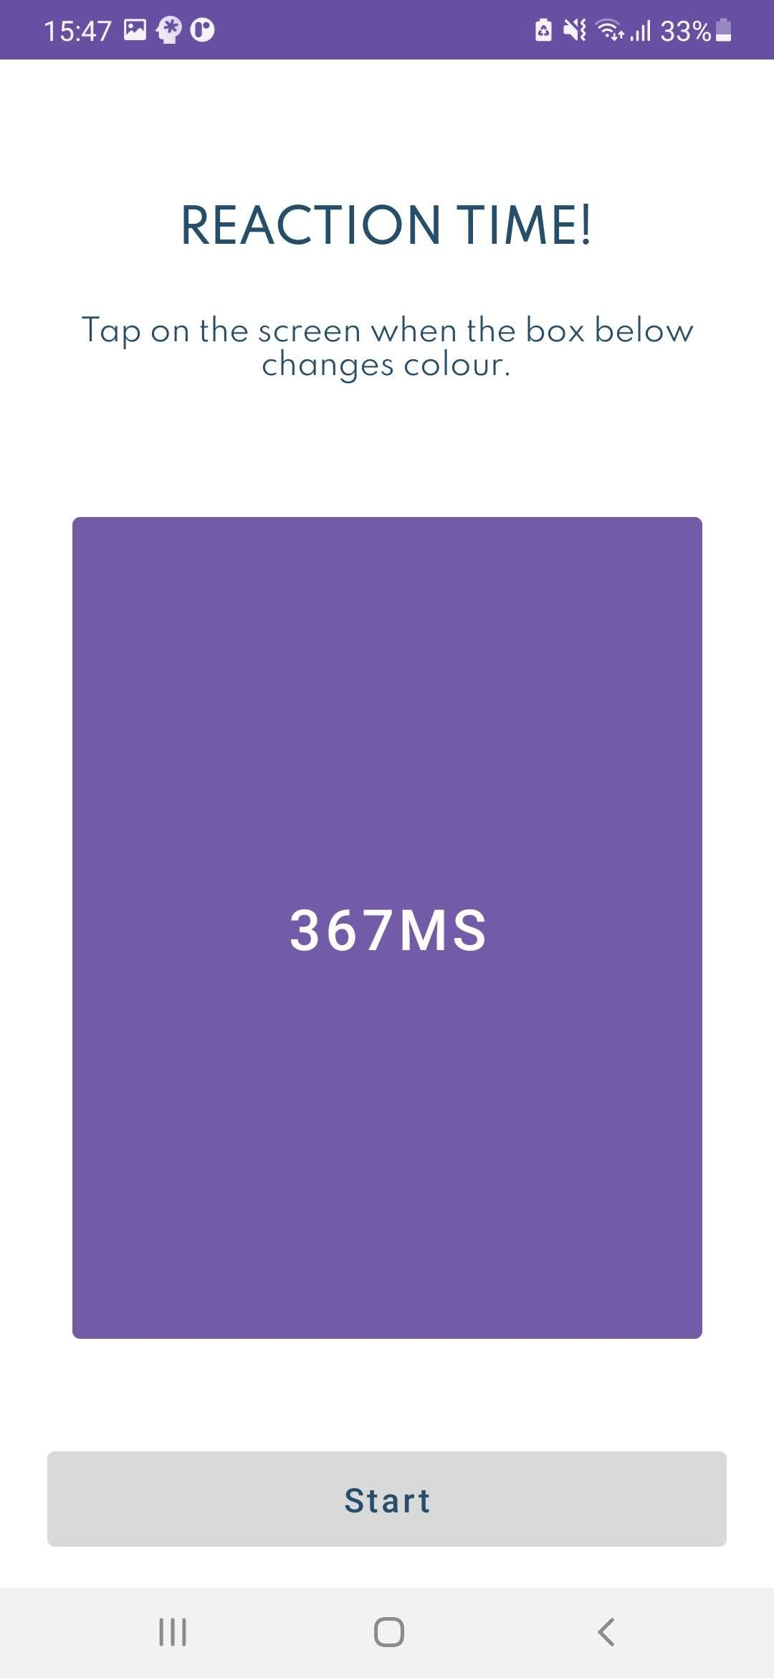
Reaction Time Tests
We implemented a 3 minute reaction time test that objectively measures the time it takes for the user to respond to a particular stimulus. Since fatigue from insufficient sleep adversely affects the vigilance and attention of a person, the reaction time test is able to capture that.
When participating in the reaction time test, users will be presented a stimulus every 2-10 seconds. We have chosen the stimulus to be a colour change. When this occurs, the user will tap on the screen and his/her response time will be displayed.
This will continue for 3 minutes, and the user average will be shown at the end and saved to the database.

Slide 5
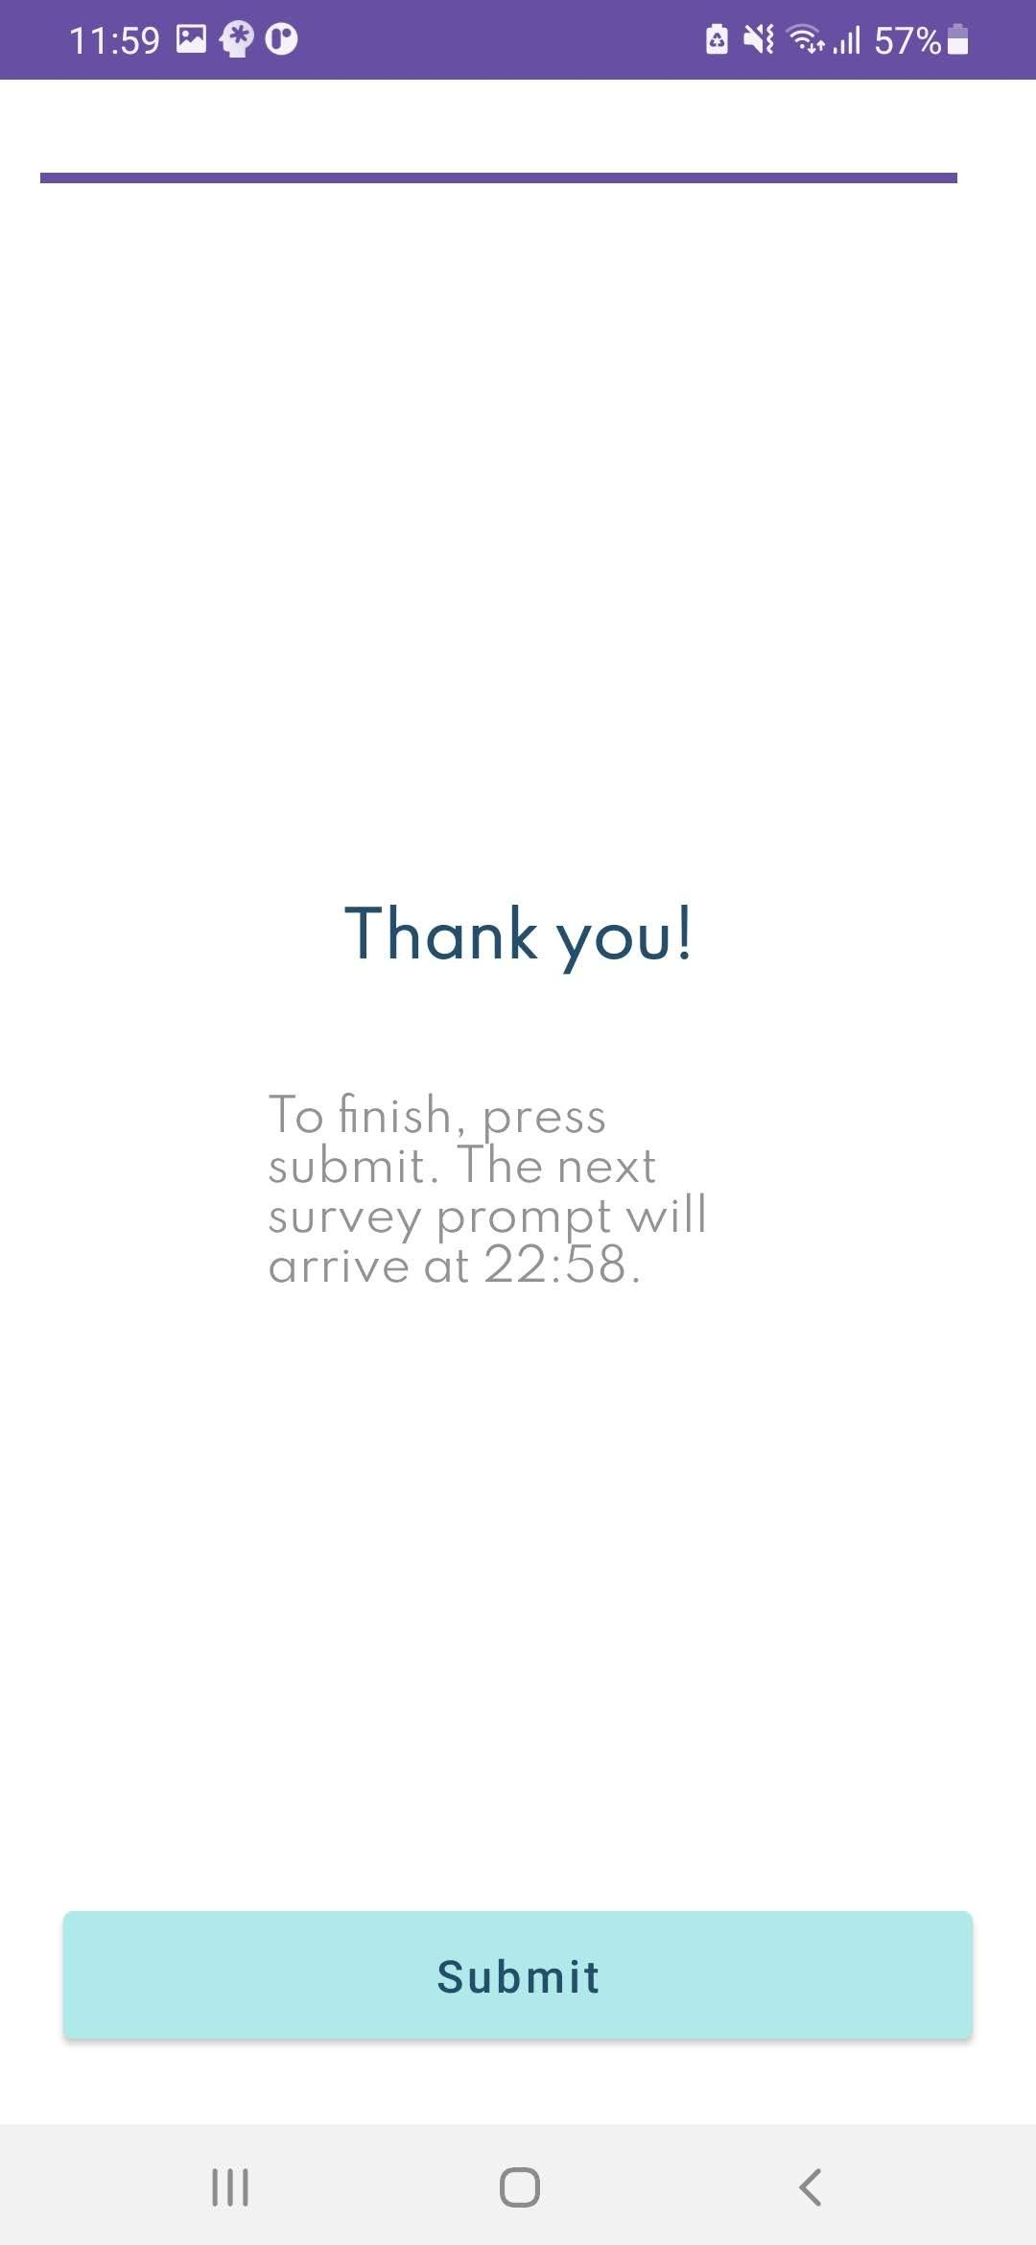
Notifications
We use regular notifications to alert the user to complete their brain fatigue surveys. These surveys build trends over time but that only works if they are done frequently and throughout the day. We use high-priority notifications that users cannot simply dismiss to grab their attention.
We also implemented an emergency notification system to detect intense volumes. This was designed to get impromptu brain fatigue results at the most exhausting part of their days.
We also use a notification alert the user to when their daily summary of results is available.

Slide 6
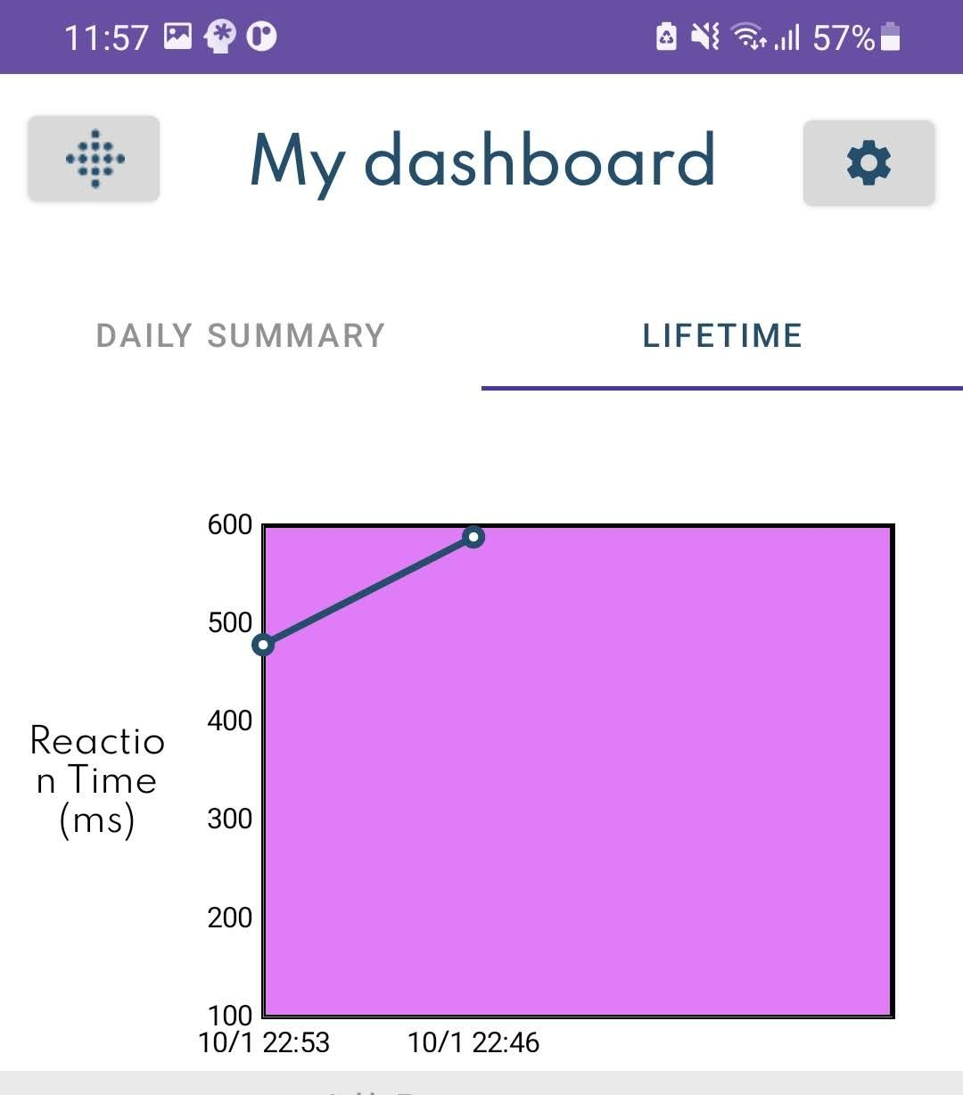
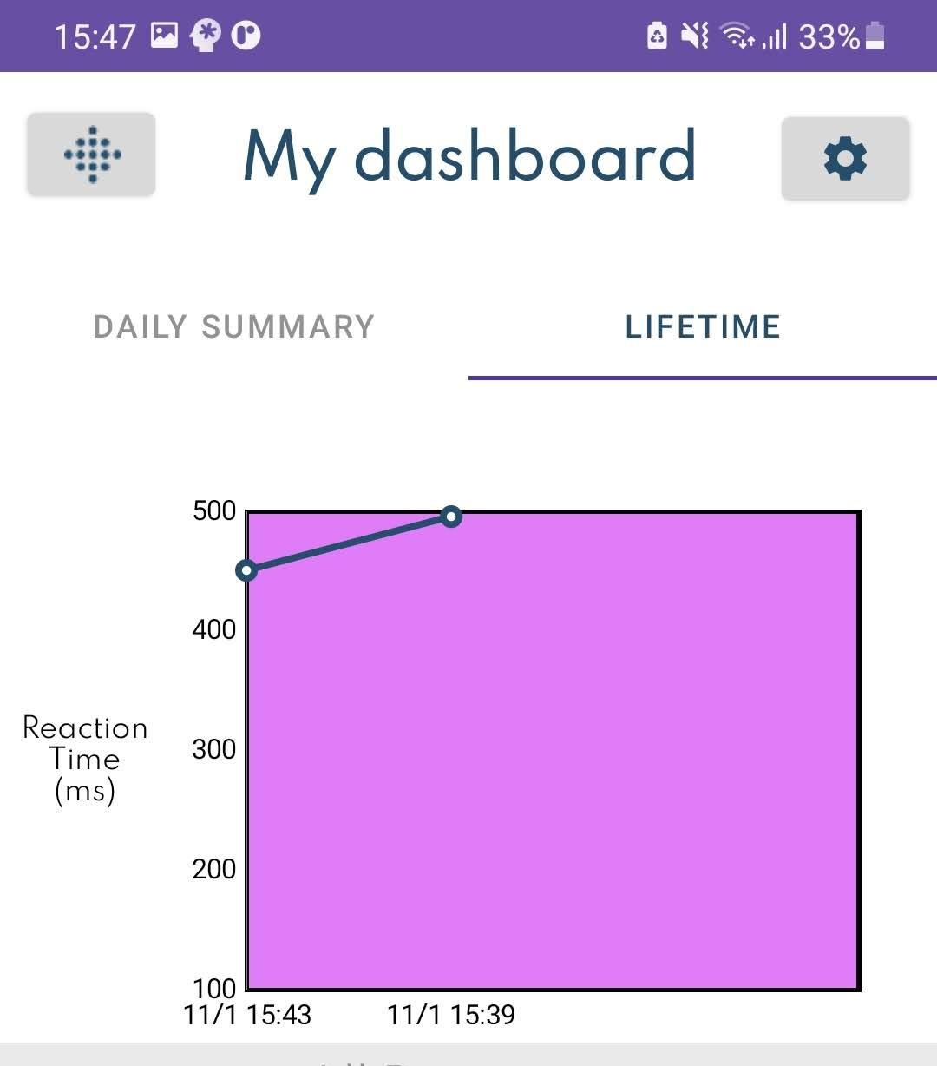
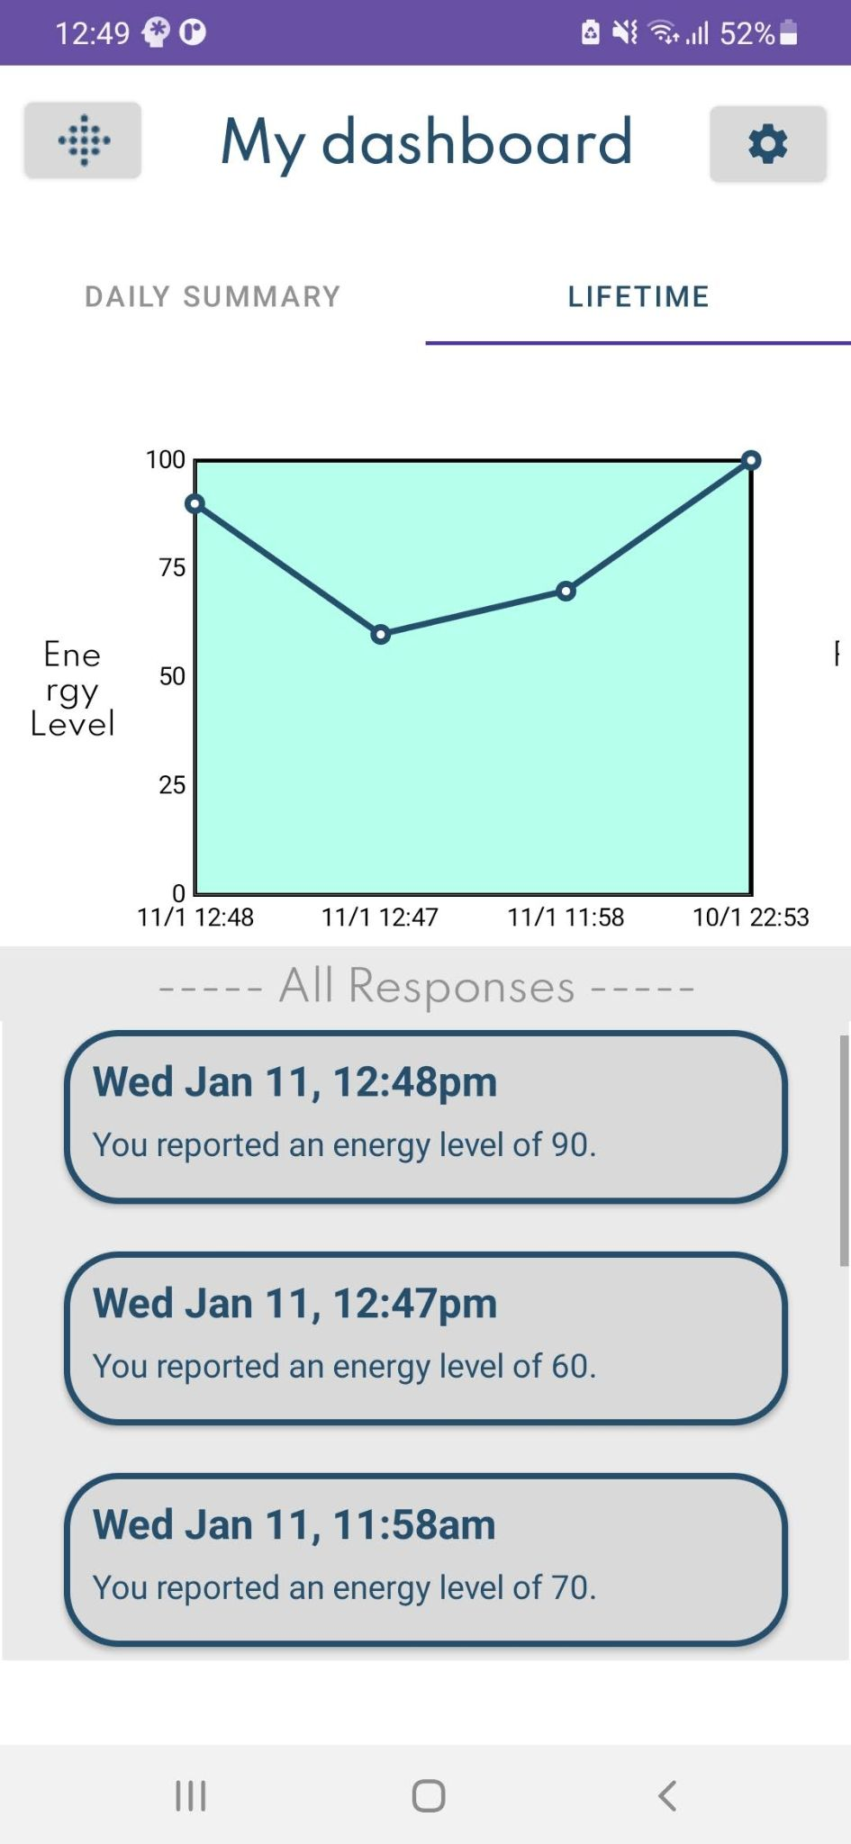
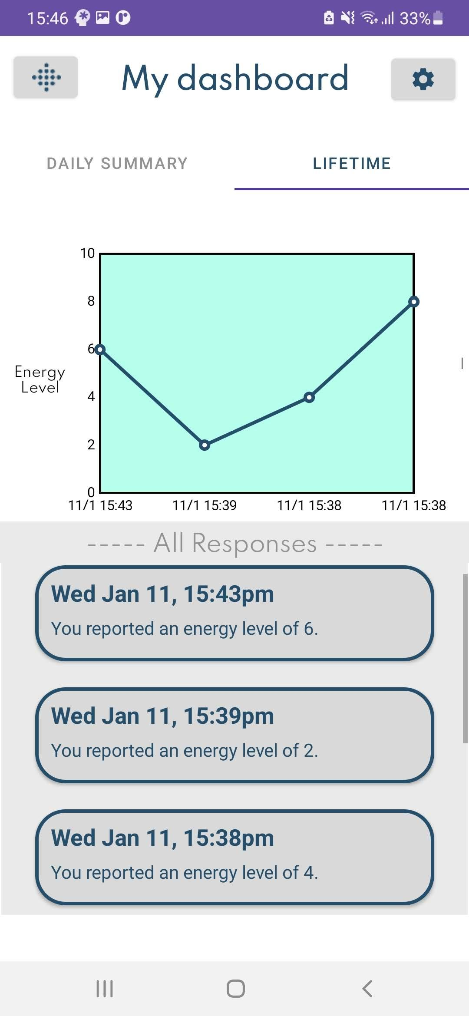
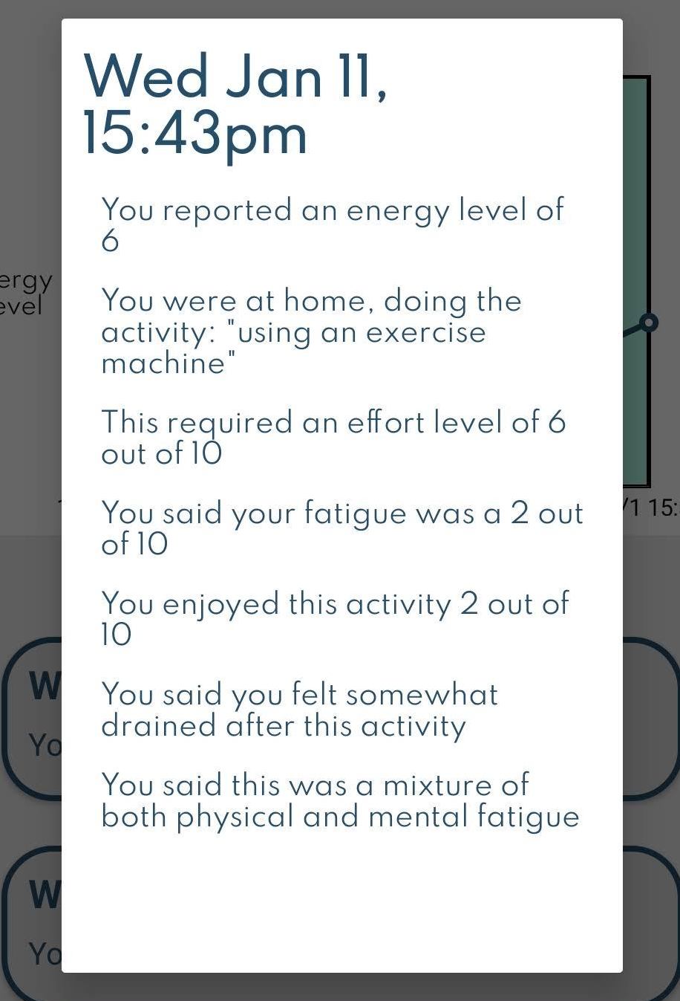
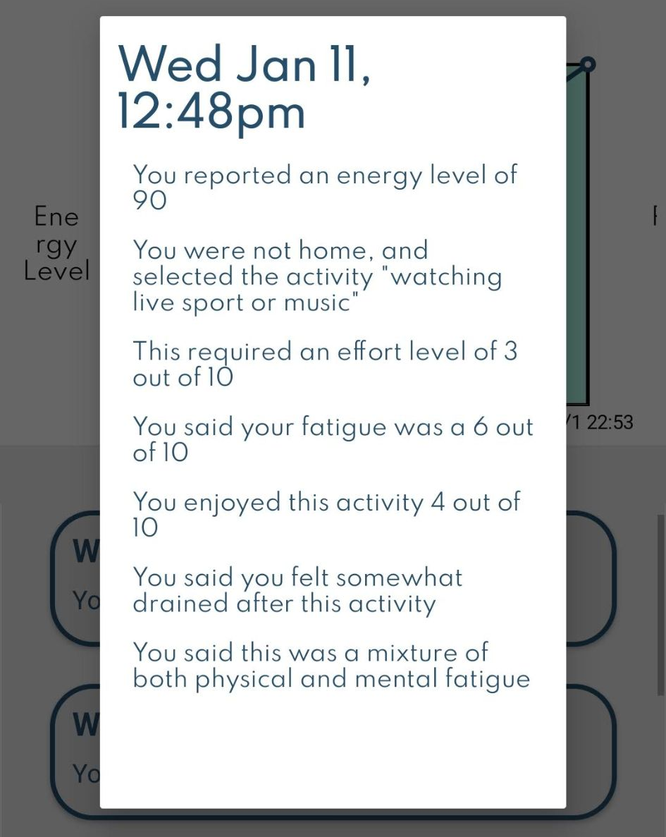
Dashboard
The data dashboard is a key area of the application as it allows users to review their responses to previously taken surveys.
It contains two tabs - one for the user’s daily summaries and one for the user’s lifetime data.
Each section contains graphs of the user’s data over time, as well as a list of all past responses.
Notes:
[stores lifetime data, good because it allows them to see what they submitted in responses they would have otherwise forgotten about → This helps users begin to understand the causes / identify trends/patterns in their fatigue]
[Explain the difference between the two sections]
[Explain what each of the graphs are, explain that you can view the full data in the pop-up (shown in bottom right)

Slide 7
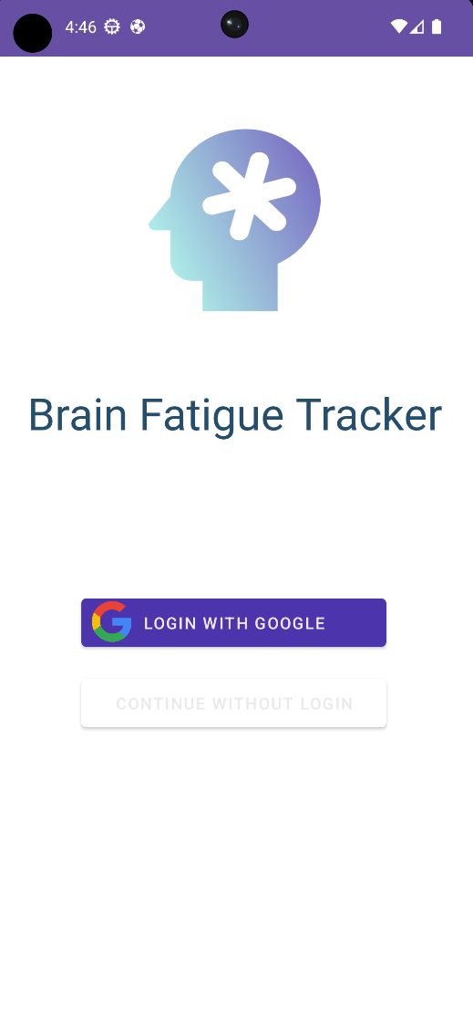
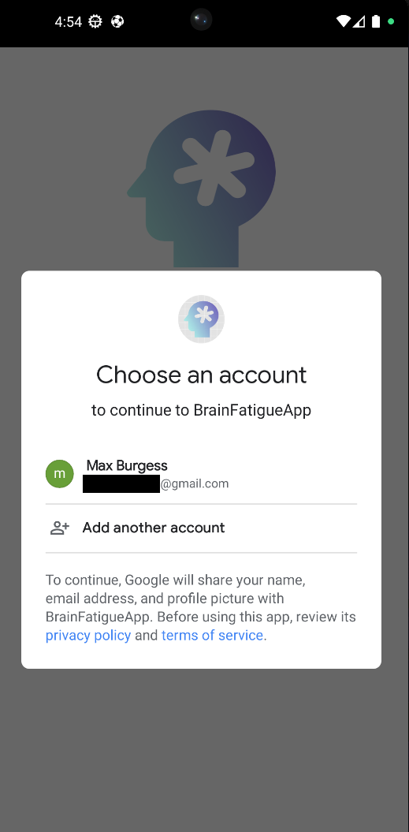
Login Page
Two options for login, to login with google and a new skip login option.
These two options are chosen as they are both universally accessible as everyone if made to have a google account on android and everyone can use the continue without login. Username and password field and the signin with Facebook features shown in last iteration of the app both gone for security reasons.

Slide 8
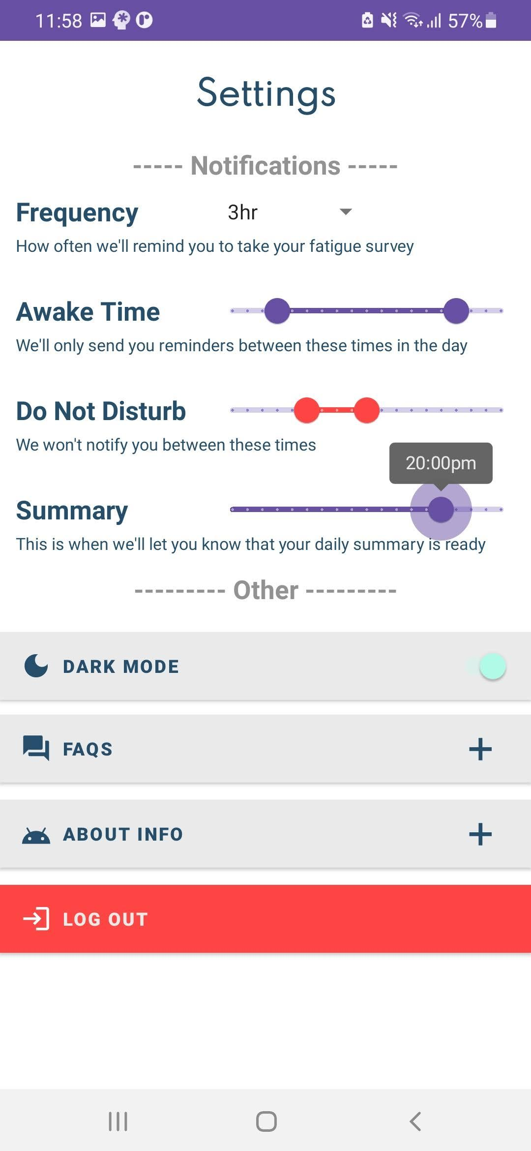
Settings
The settings page was implemented in order to meet our goal of allowing the user to customise their experience with the application.
Crucially, the user has control over the alerts that they receive. This includes adjusting the frequency of notifications and the time windows in which they can and can not be sent alerts.
The settings page also includes the things that a user would expect to find, like an FAQs section and a log out button.
Notes:
[Like most mobile applications, it has a settings page where the user can customise and set their preference.]
[Explain what each of the sliders actually do]
[Explain what final buttons do? Fairly self explanatory]

Slide 9
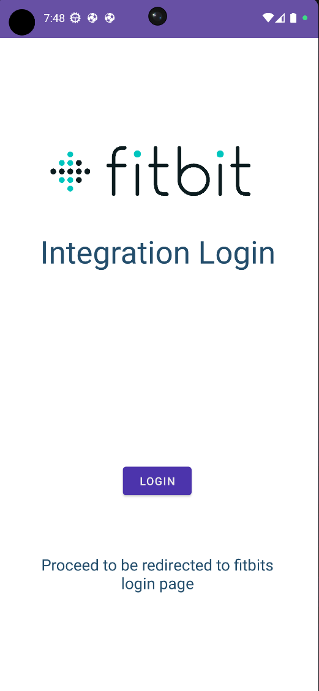
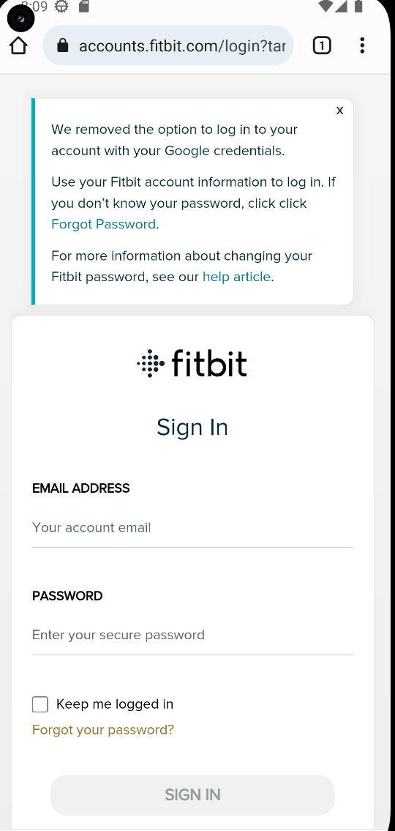
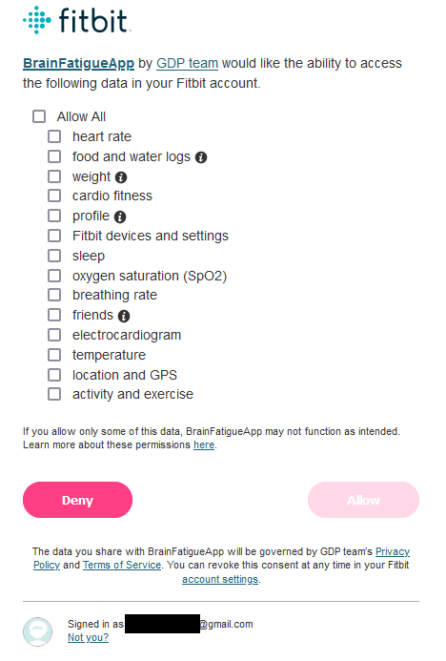
Fitbit Integration
Integrates with FitBits API using a secure Oauth 2.0 login. Allows us to collect data which may be hard or even impossible to collect from a survey such as heart rate. Doesn’t have to be constantly connected, can pull data from the entire users history so they can do one big “sync” at the end of the study for convenience if they don’t feel like seeing the data as they go along.

Slide 10
User Feedback
The feedback is summarised as follows:
User friendliness: 78% of participants agree/strongly agree on the user friendliness of the app. 11% of which gave neutral responses.
Confused: participants were mostly confused about the battery slider question due to the static image; least confused about user survey, PVT, and dashboard.
Stress levels: dashboard is the least stress inducing; PVT as the highest stress inducing overall.
Some comments/suggestions:
Having more options for the types of activities would be better
Reaction time test might be too long.
Lifetime graph on dashboard might accumulate too many data points over time, so giving the user the ability to view a certain range would be a plus.
Battery level image should change with the slider.
Colour gradient on the homepage might make the text difficult to read by people with visual impairments.
We tested the app on some of our friends and family and were able to get their feedback through a Google Form.
For each of the key features of the app, we ask participants of the survey the following:
Their opinions on the user friendliness of the feature. (5 point psychometric/Likert scale)
How confused they are by the page that is being shown to them.
Their stress levels when on the page/using the feature.
Any additional comments and suggestions they would like to make.
Notes:
13 strongly agree, 29 agree, 6 neutral, 3 disagree, 0 strongly disagree
Most confused by battery slider question, least confused about the user survey, reaction time test, and dashboard
Most stressed PVT, user survey and settings page come in second

Slide 11

Review of Project Objectives
Technical Objectives:
1. Daily summaries of survey data
2. Implement a reaction time test
3. Data collection from external devices
4. Implement user customisation
5. Make the UI and UX user-friendly
6. Test a prototype of the app on OT students
Stretch Objectives:
1. Implement a long-term calendar
2. Implement charts for long-term trends
3. Further compatibility with external devices
4. Implement a survey for impromptu recordings
5. Create an Android widget to display data

Slide 12
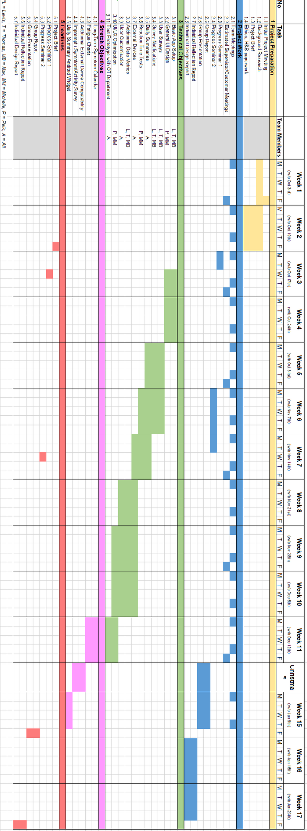
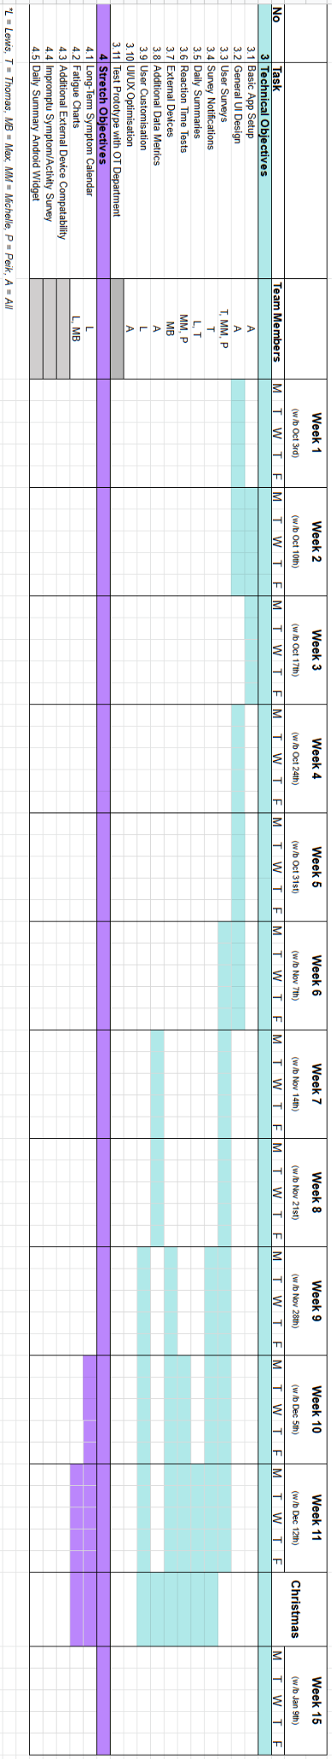
Gantt Chart

Slide 13
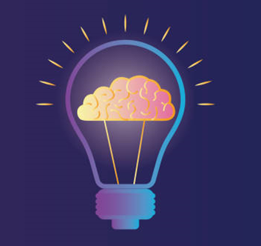
Conclusion
Met all the technical objectives except for testing with the OT department - improved UI design, reaction time test - login options with Google/Facebook - dashboard as a form of feedback to users - settings page; more robust notification system; caters to an individual’s daily routines - integration of data from FitBit - user feedback from students
Future ideas/work -surveys to provide accessibility support -reaction test customisation -extending integration with external devices -stretch objectives; android widgets, display long-term fatigue progress and trends
Notes:
Made the UI design to cause less strain on users as blue was a colour which provided more relief for the users
The reaction time test had a random variation after each colour change
Settings page which caters to user customisation as it was a primary focus based on our customer’s research which includes adjusting notifications that could cater to an individual person’s daily routine
Login Page with google and facebook which could potentially help patients with memory retention issues by reducing the number of times they have to log in.

Slide 14

Video

